Slide 1
Introduction to
www.united-oil.com

Slide 2
WIRANTO GROUP COMPANY

Slide 3
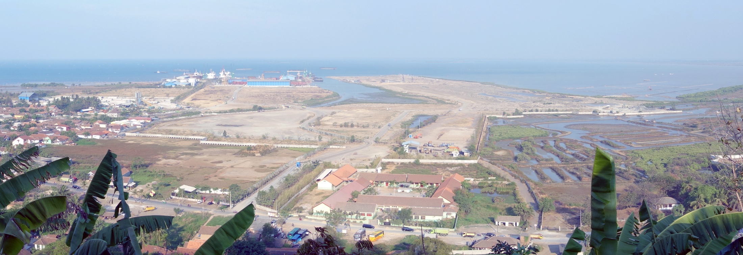
WIRANTO GROUP COMPANY
4
2
3
1
Developer and Construction
www.united-oil.com

Slide 4
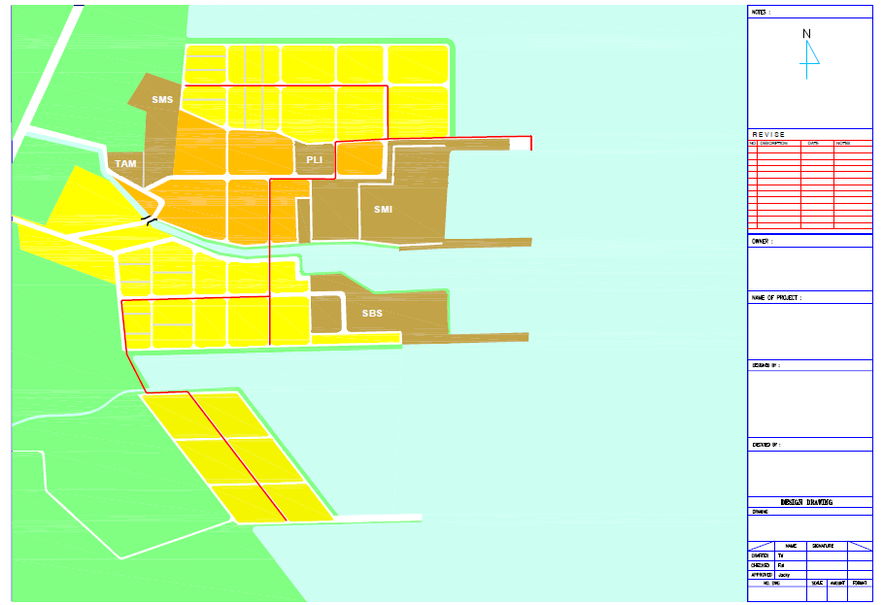
Chemical
Process Plants
Phase 4 (40 ha)
Tank farms
Common pipe-rack
Tank farms
Jetty 1, 2 & 3 – Oil Products/Chemical Terminal
Phase 1 (50 Ha)
Tank farms
Jul’12 Ph3 changed to 63 Ha
Emergency Services – Fire Brigade, Clinic
Offshore Logistics Centre
Central Utilities
Jetty 4
Warehouse &
Logistics Centre
Wiranto Group
Phase 2 (50 ha)
Chemical
Process Plants
U/C
Jetty 6
Bojonegara
Industrial Estate
Master Plan v2
July 2012
Common pipe-rack
Phase 3 (63 ha)
Tank farms
Tank farms
500 m
3C
Chemical
Process Plants
3A
Jetty 8 – Oil Products/Chemical Terminal
3B
Phase 1 (50 Ha) 2005 to 2012
Phase 2 (50 Ha) 2011 to 2016
Phase 3 (63 Ha) 2014 to 2019 3A will be first to be reclaimed
Phase 4 (40 Ha) 2016 to 2021
SMI, SBS – Ship building/repair
SMS, TAM – Quarry processing
PLI – Tankage & LOBP
www.united-oil.com

Slide 5
WIRANTO GROUP COMPANY
Shipyard – Build, Service & Dry Dock
www.united-oil.com

Slide 6
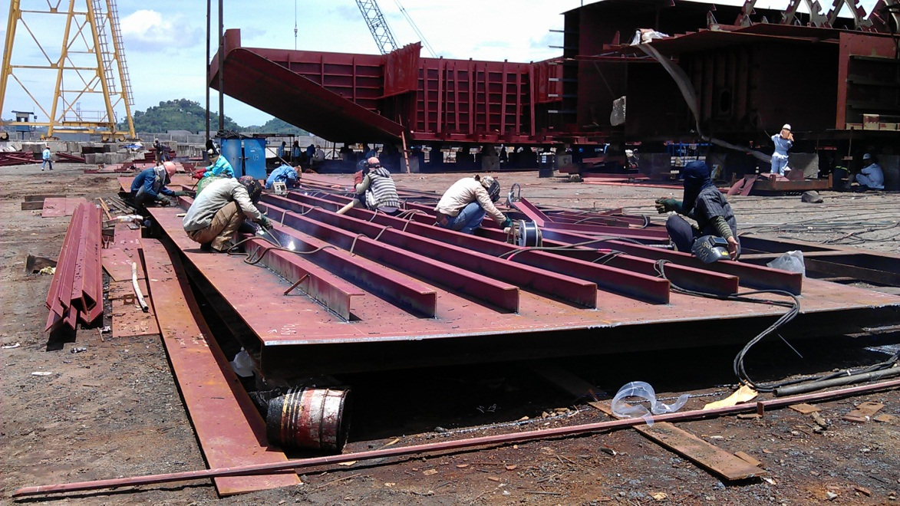
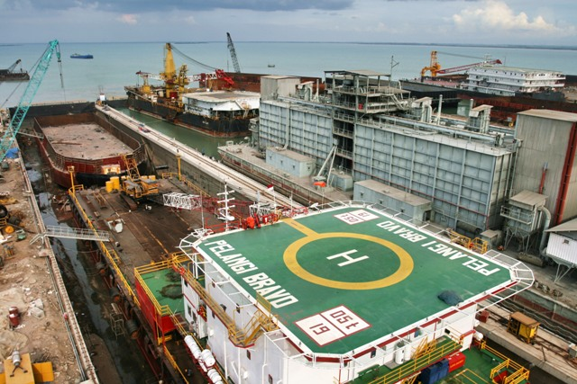
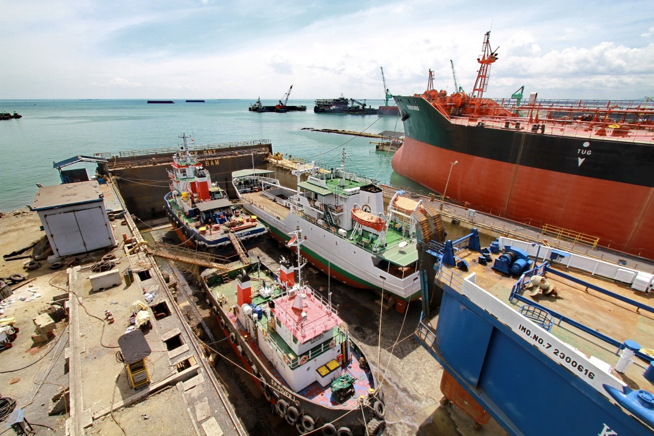
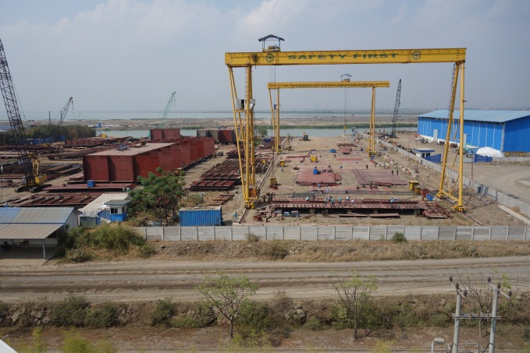
WIRANTO GROUP COMPANY
Shipyard – Build, Service & Dry Dock
www.united-oil.com

Slide 7
WIRANTO GROUP COMPANY
Shipyard – Build, Service & Dry Dock
www.united-oil.com

Slide 8
WIRANTO GROUP COMPANY
Shipyard – Build, Service Tug & Barge
www.united-oil.com

Slide 9
WIRANTO GROUP COMPANY
Tug Boat & Barge Chartering Fleet
www.united-oil.com

Slide 10
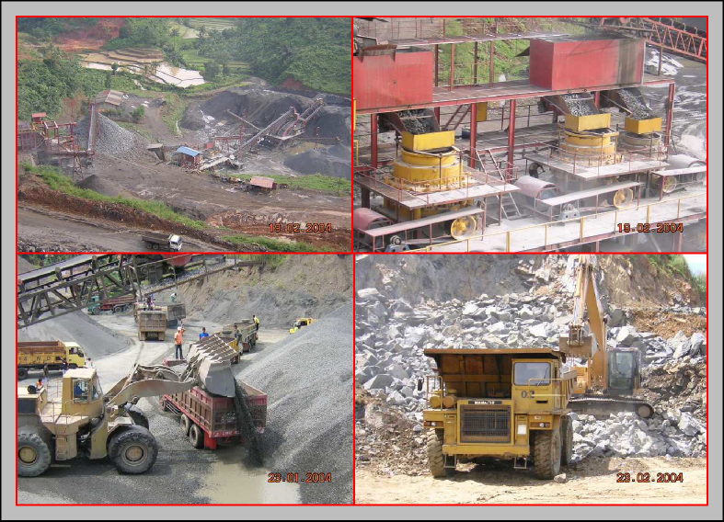
WIRANTO GROUP COMPANY
Stone Quarry
www.united-oil.com

Slide 11
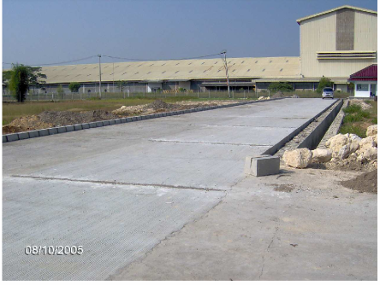
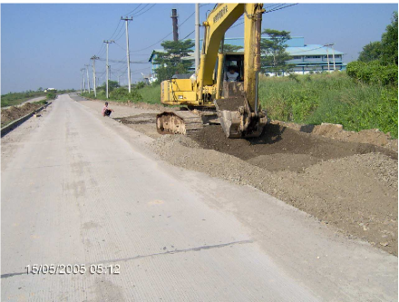
WIRANTO GROUP COMPANY
Tug Boat & Barge Chartering Fleet
www.united-oil.com

Slide 12
WIRANTO GROUP COMPANY
Crane Sales, Rental & Services
www.united-oil.com

Slide 13
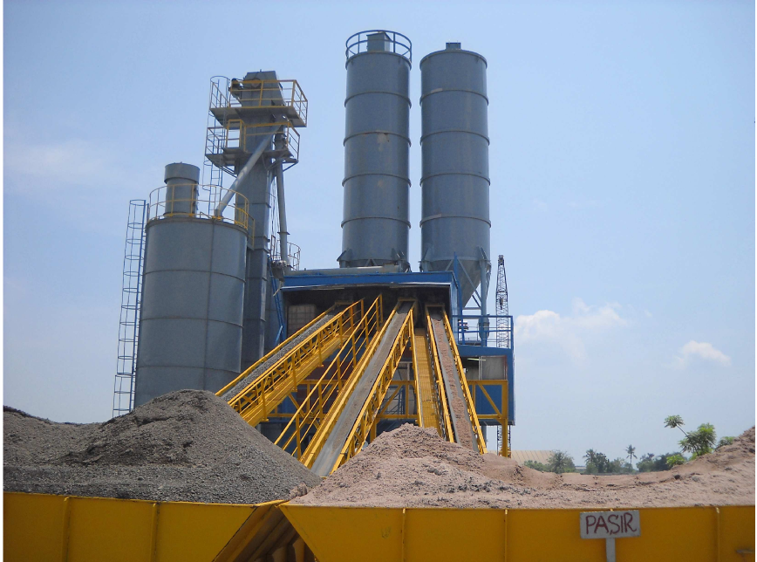
WIRANTO GROUP COMPANY
Cement Premix & Concrete Pile
www.united-oil.com

Slide 14
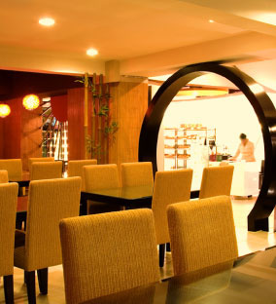
WIRANTO GROUP COMPANY
Restaurant & Bakery
www.united-oil.com

Slide 15
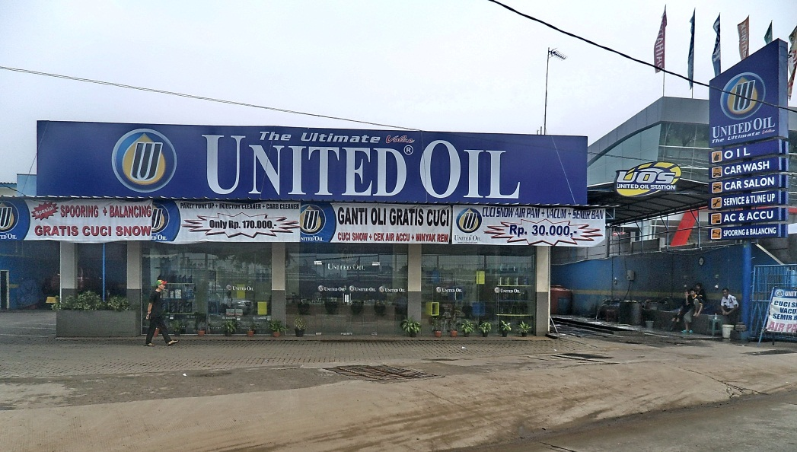
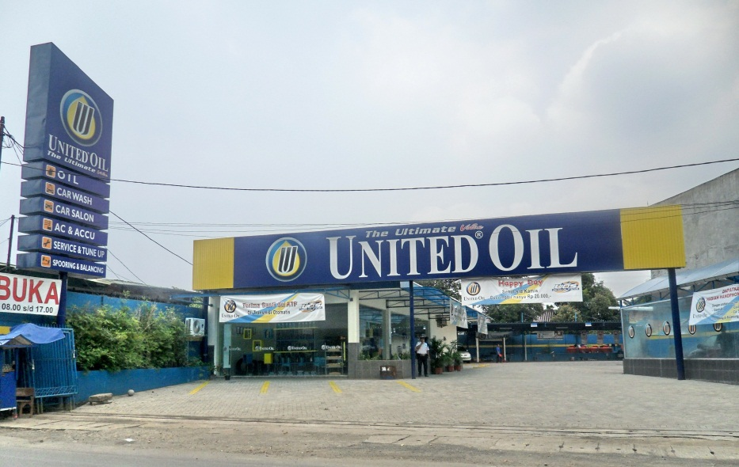
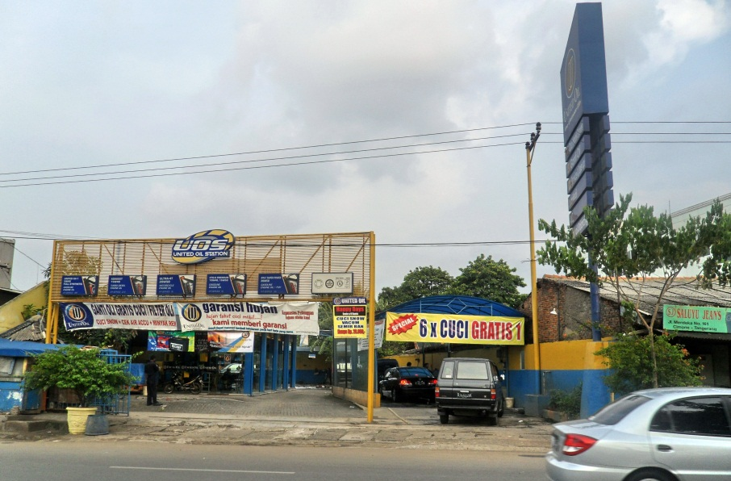
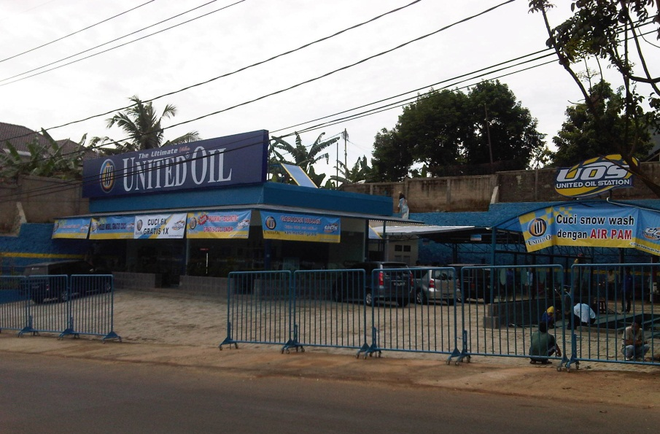
WIRANTO GROUP COMPANY
Auto Service Station
www.united-oil.com

Slide 16
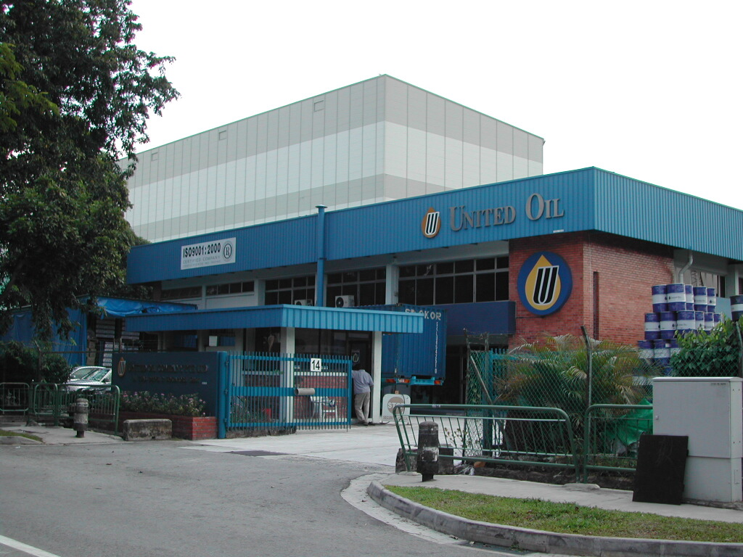
WIRANTO GROUP COMPANY
Lube Oil Blending Plant
www.united-oil.com

Slide 17
The Company
Incorporated in the Republic of Singapore in early 1999.
Plant originally designed and built by an US Oil Major company, expanded and upgraded to suit to meet our requirement.
Managed by a team of lubricants professionals.
Produces high quality lubricants and petroleum specialty.
www.united-oil.com

Slide 18
The Company
Located in Jurong, Singapore’s largest industrial estate.
Manufacturing capability includes storage, blending & filling (bulk, drums, pails, cans & bottles).
Laboratory with state-of-art equipment capable of full QA / QC test.
Logistics & administration support.
Market driven & export oriented.
www.united-oil.com

Slide 19
Singapore Plant
4,000MT of Base Oil storage facility.
Dual functions bulk tanks – for storage and blending.
Blending capability at 3,000MT / shift / month.
www.united-oil.com

Slide 20
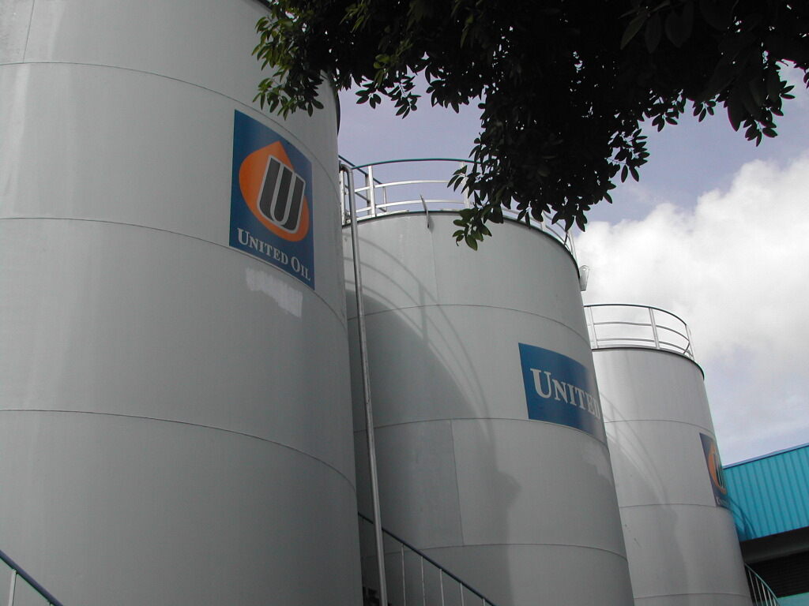
www.united-oil.com

Slide 21
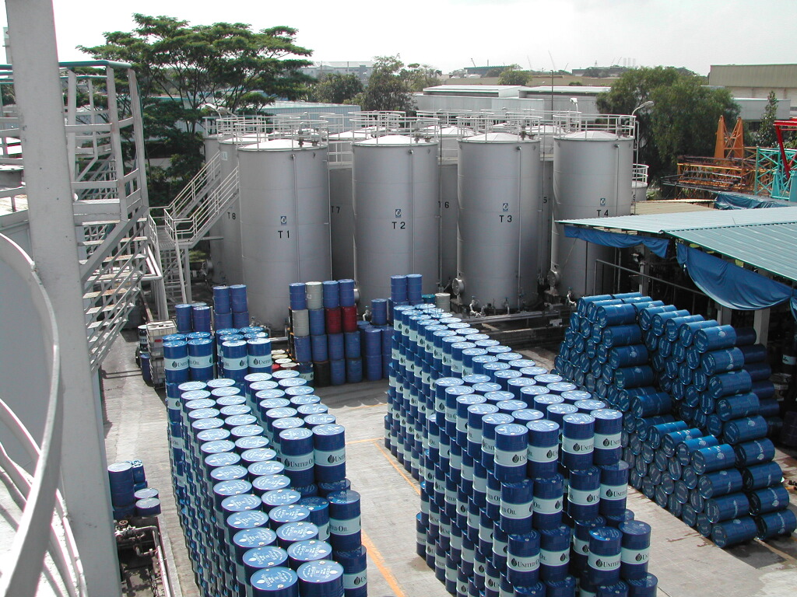
www.united-oil.com

Slide 22
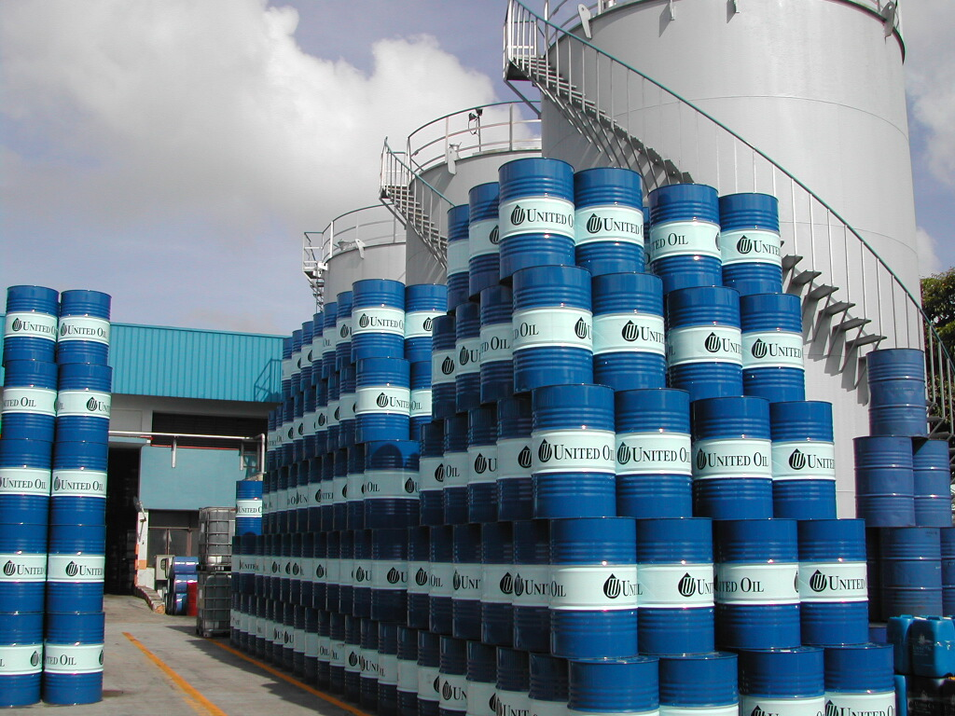
www.united-oil.com

Slide 23
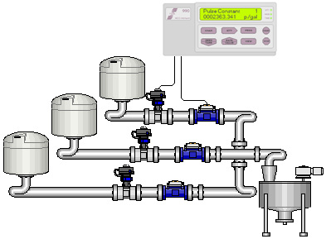
Blending Process
Base Oil
Additive
Additive
www.united-oil.com

Slide 24
Additives
www.united-oil.com

Slide 25
Singapore Filling Capacity
2 Drum Filling Line. Rate at 1,000 drums/shift.
2 Small Pack Line. 1x6 & 1x8 nozzles with capacity of 2,500 carton/shift.
1 Pail Filling Line. Capacity at 1,000 pails/shift.
1 Grease Filling Line.
1,000L IBC Filling.
ISO Container / Flexibag / Road Tanker filling.
www.united-oil.com

Slide 26
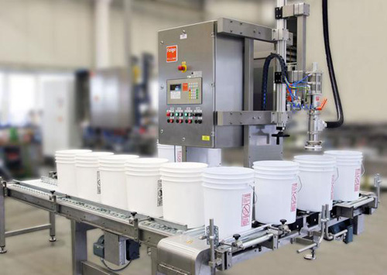
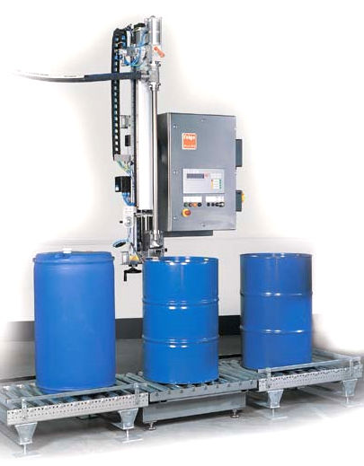
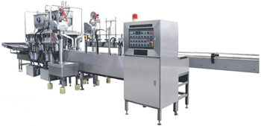
Filling Process
www.united-oil.com

Slide 27
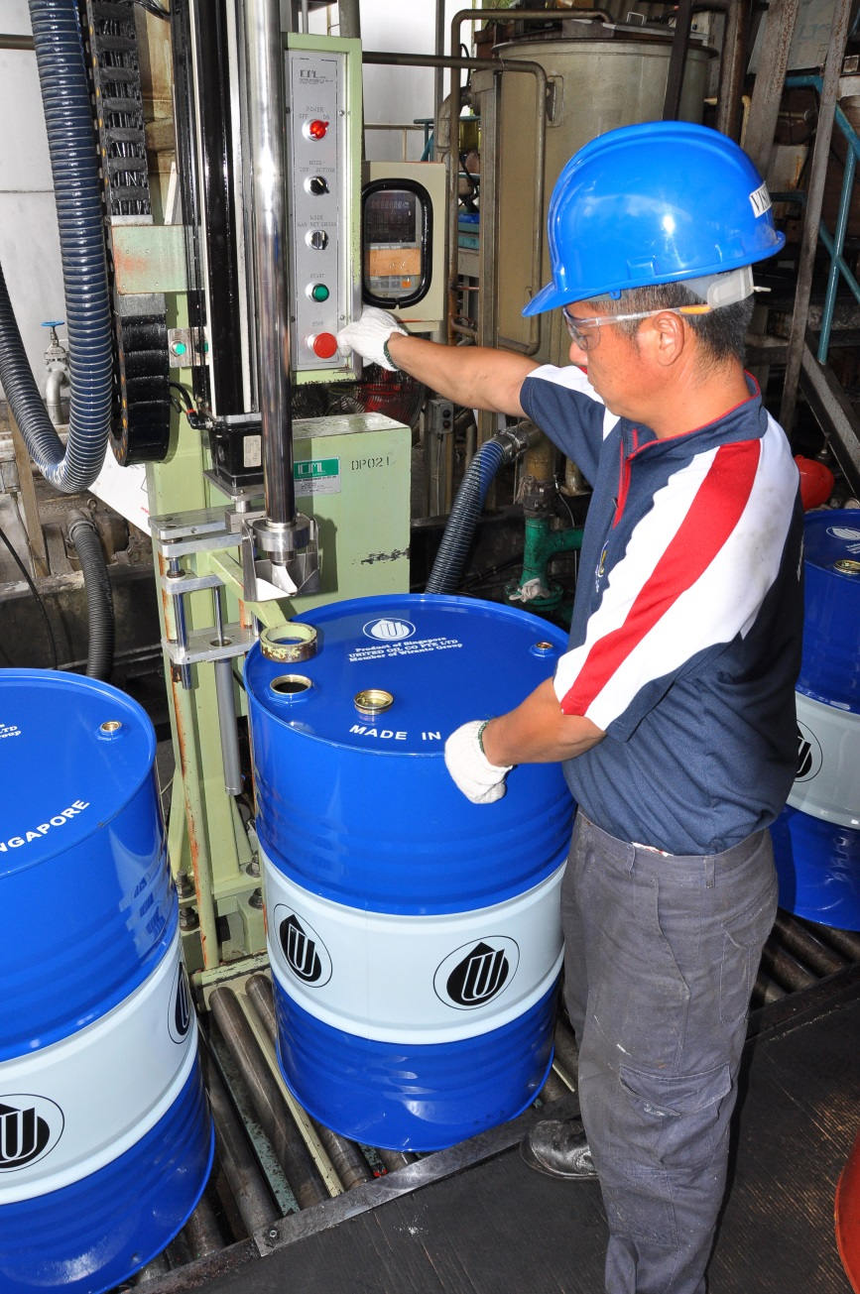
Drum Filling Line
www.united-oil.com

Slide 28
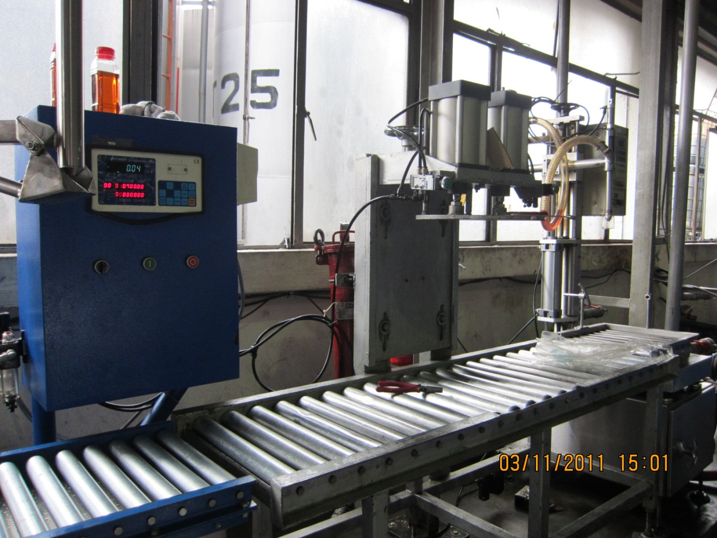
18L~25L Pail Filling Line
www.united-oil.com

Slide 29
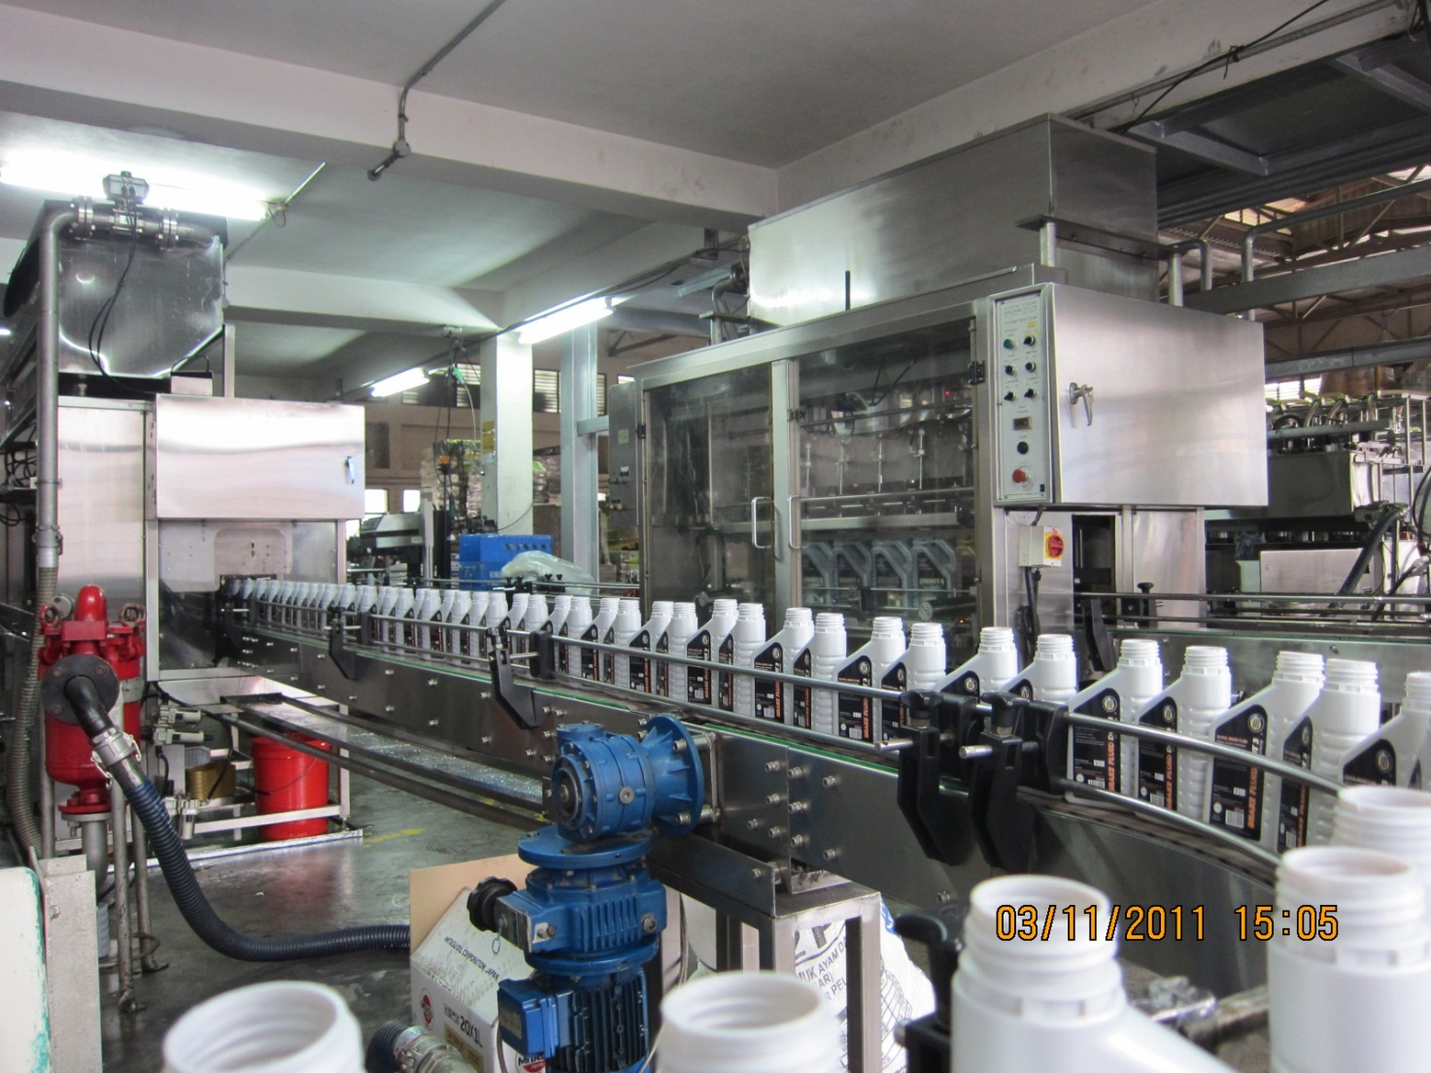
6 & 8 Nozzles Filling Machine
www.united-oil.com

Slide 30
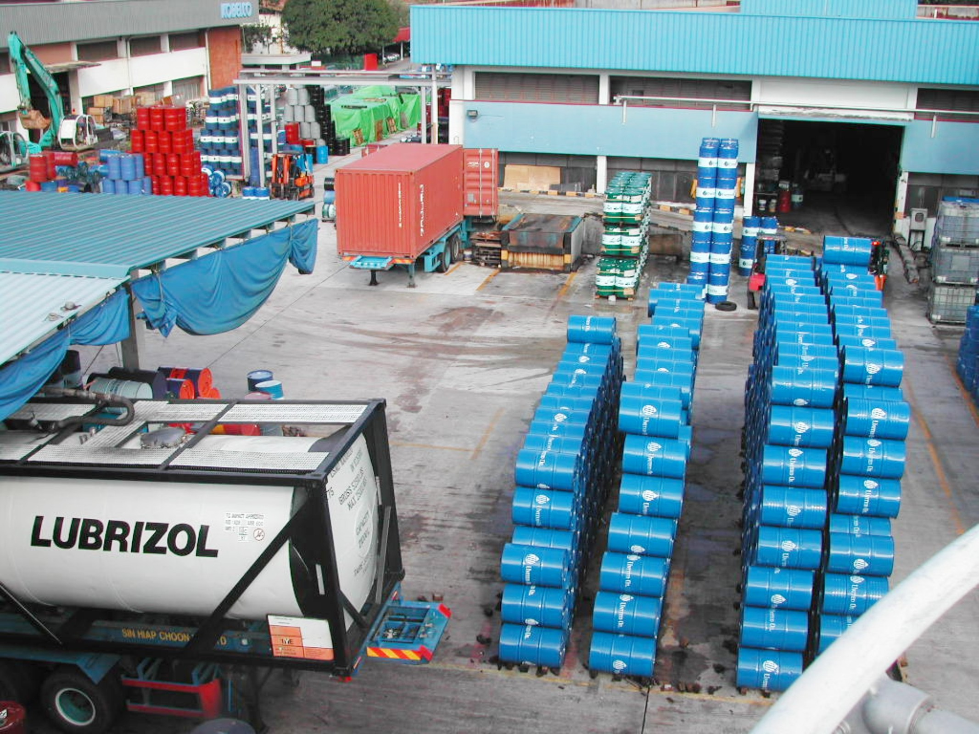
www.united-oil.com

Slide 31
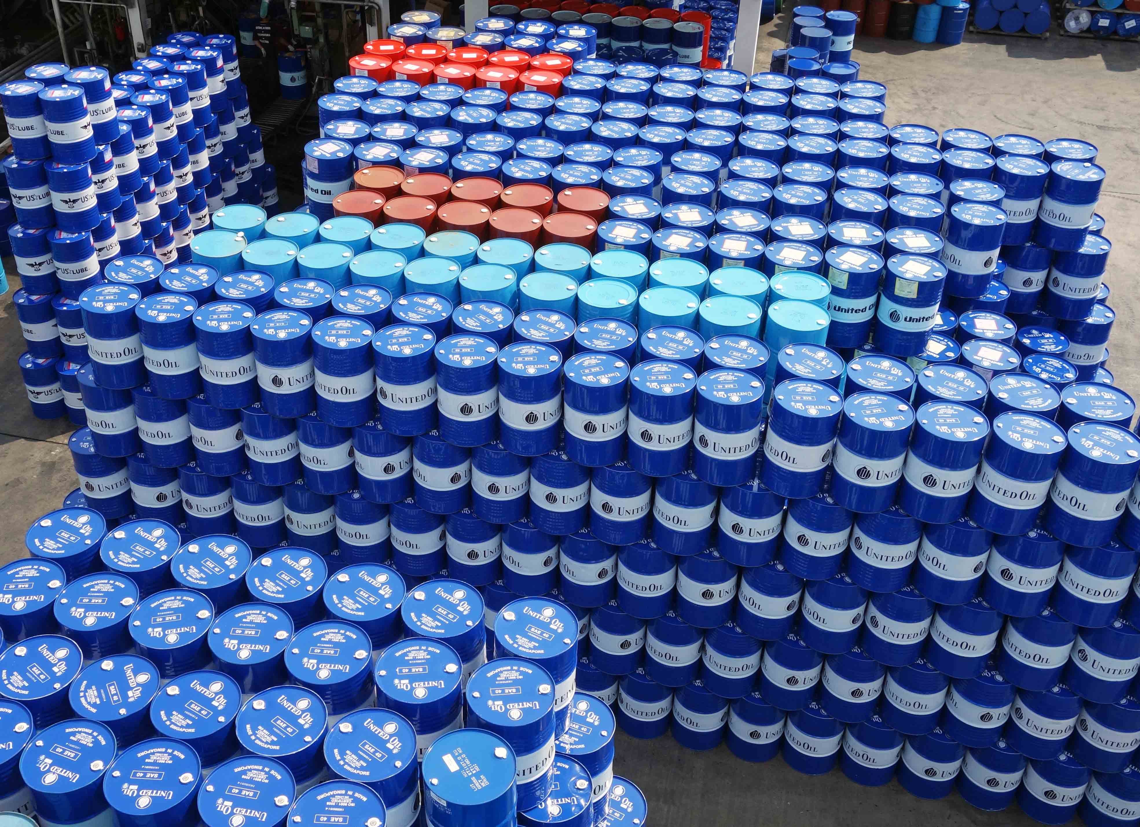
Drum Packing
www.united-oil.com

Slide 32
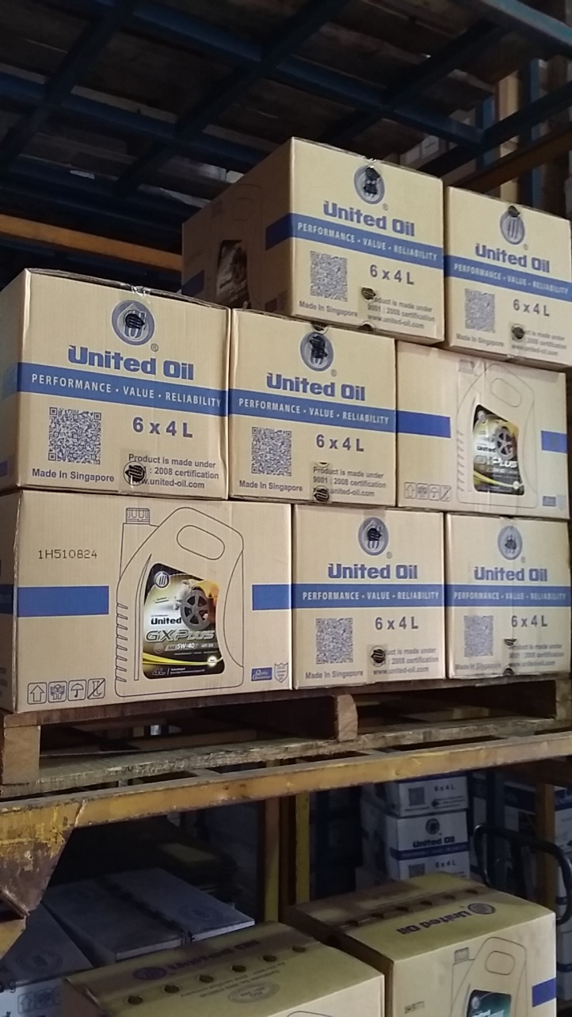
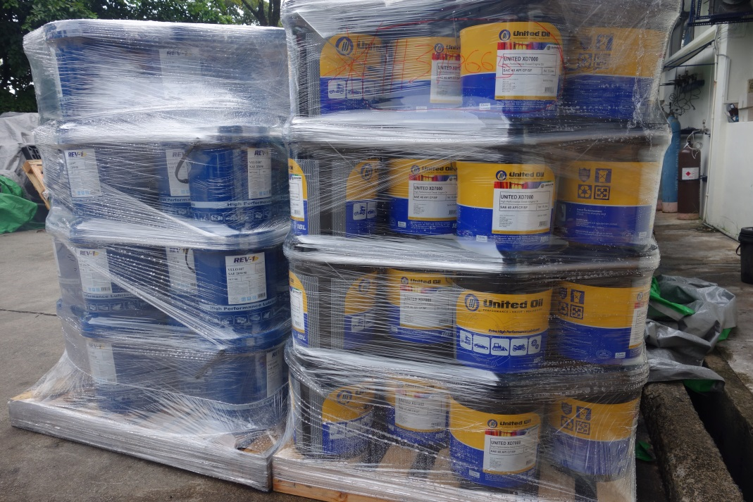
Various Small Packing
www.united-oil.com
www.united-oil.com

Slide 33
QA & QC
Kinematic Viscosity.
Pour Point.
Flash Point (COC, PMCC).
TBN / TAN.
Cold Cranking Simulator (CCS).
Foam Testing.
S.G. / Density Determination.
Color (ASTM D1500).
Metals Analysis (AA).
Demulsibility.
High Temperature High Shear (HTHS).
www.united-oil.com

Slide 34
QA & QC
Mini Rotary Viscosity Tester (MRV).
Water Content (Karl Fischer).
Quenchometer.
PH Meter.
Refractometer.
Furnace (800 Degree C).
FTIR.
www.united-oil.com

Slide 35
www.united-oil.com

Slide 36
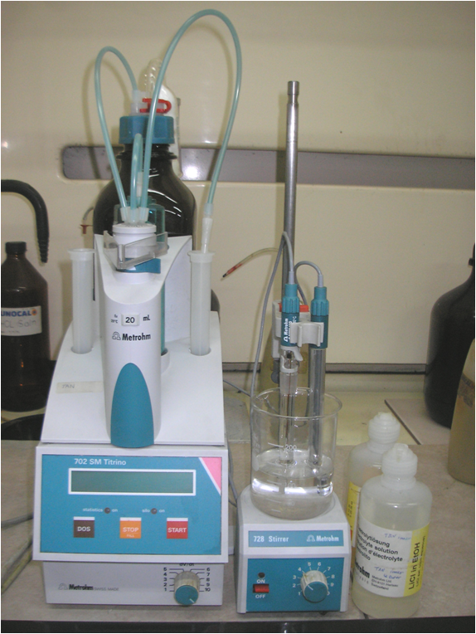
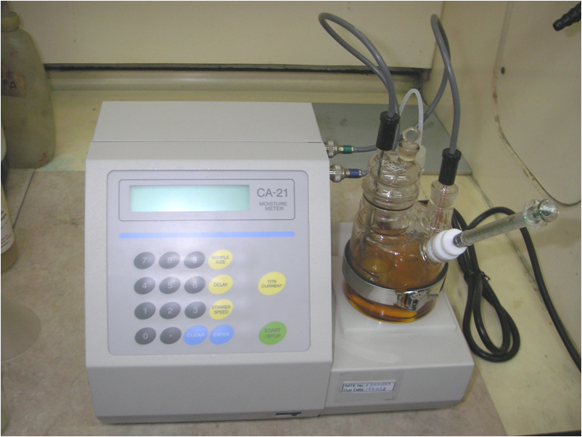
TBN / TAN
Tester
Karl Fischer
Tester
www.united-oil.com

Slide 37
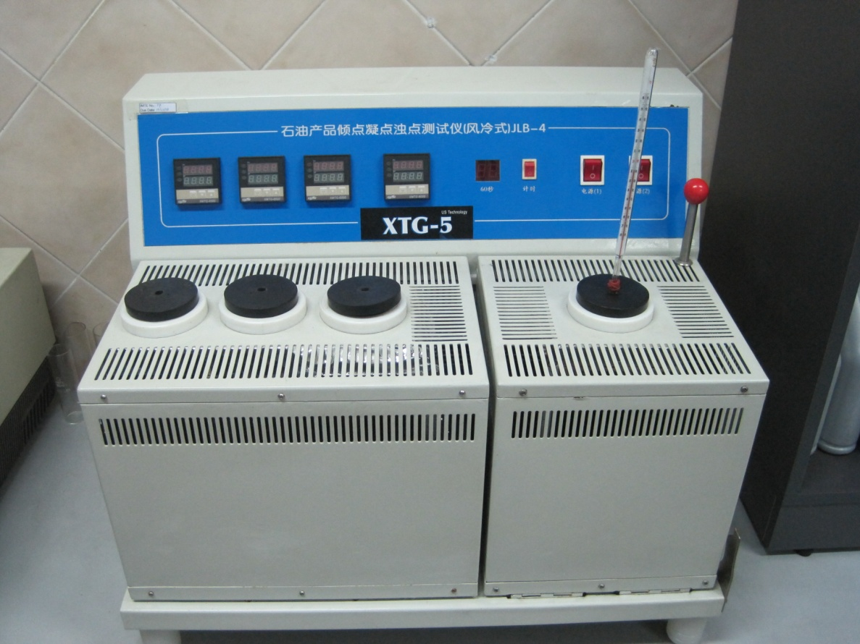
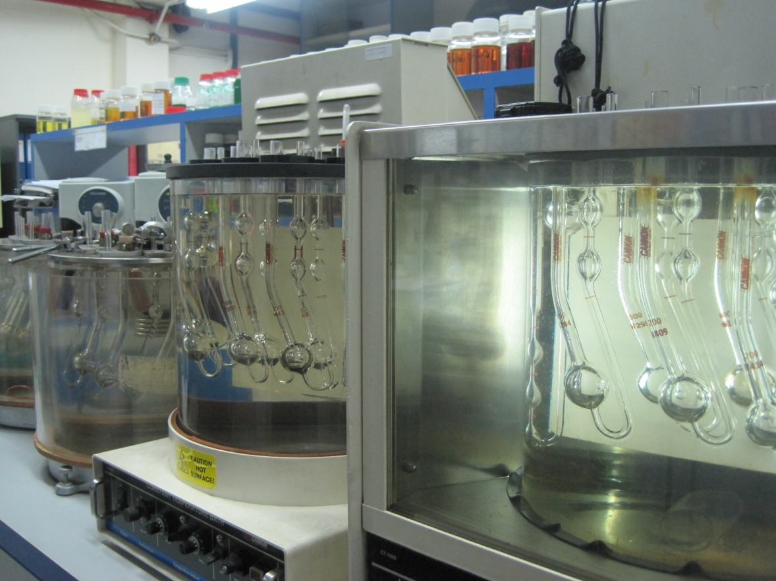
Pour Point Tester
Kinematic Viscosity
(40 oC & 100 oC)
www.united-oil.com

Slide 38
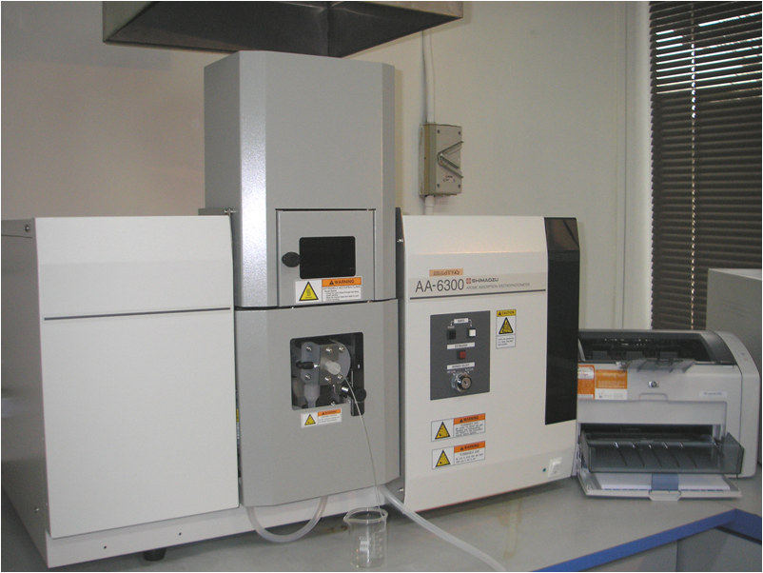
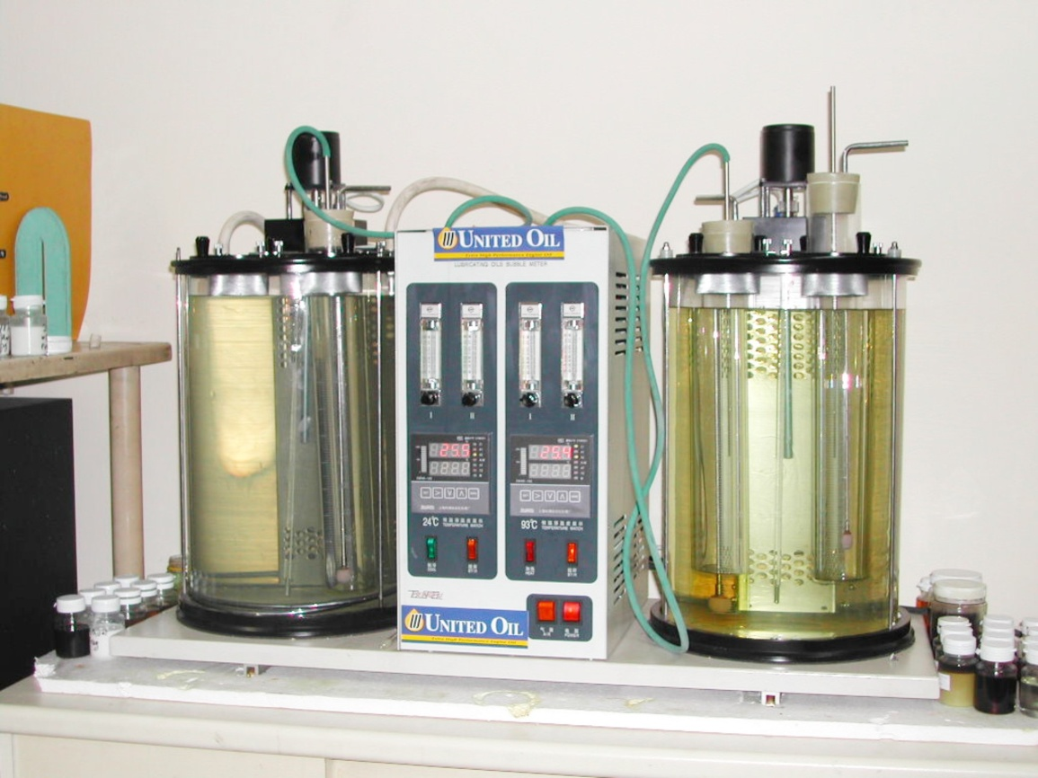
Atomic Absorption
Spectroscophy
Foam Test
www.united-oil.com

Slide 39
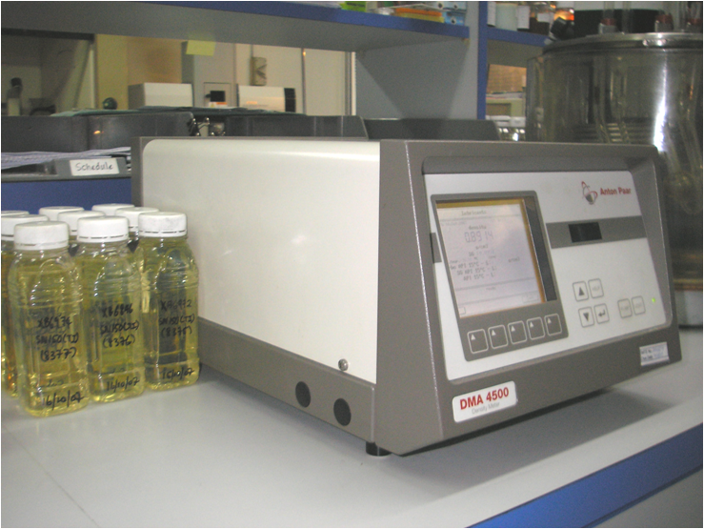
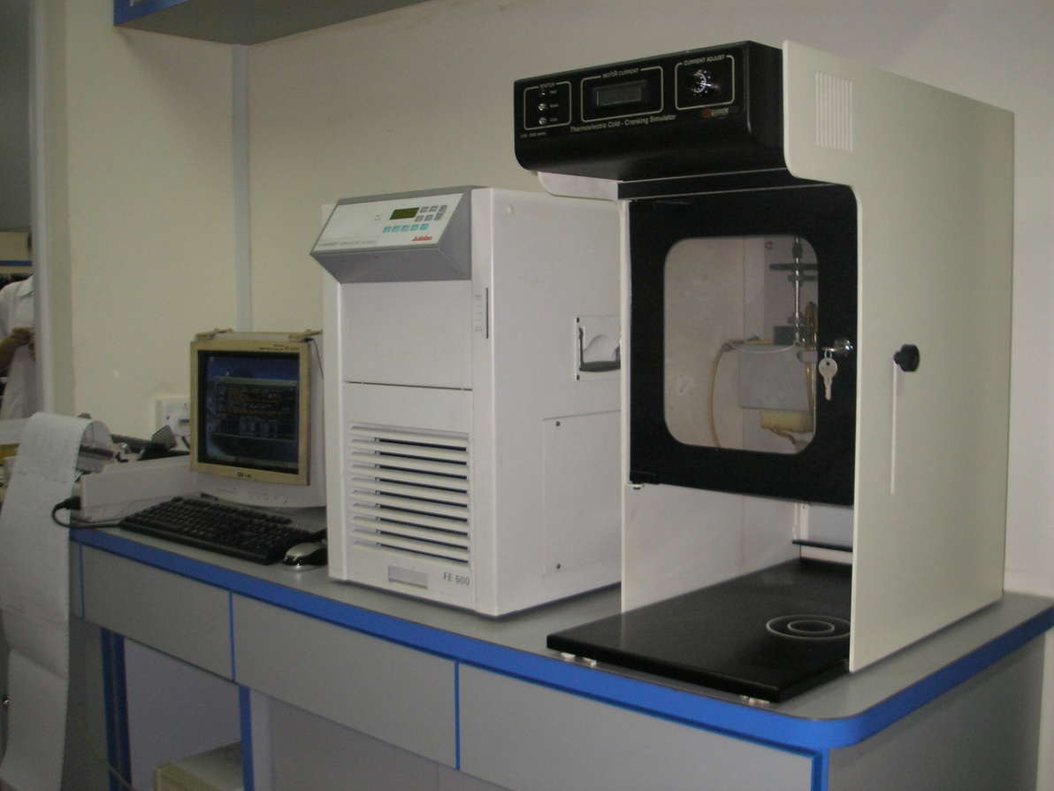
Density Tester
Cold Cranking
Simulator
www.united-oil.com

Slide 40
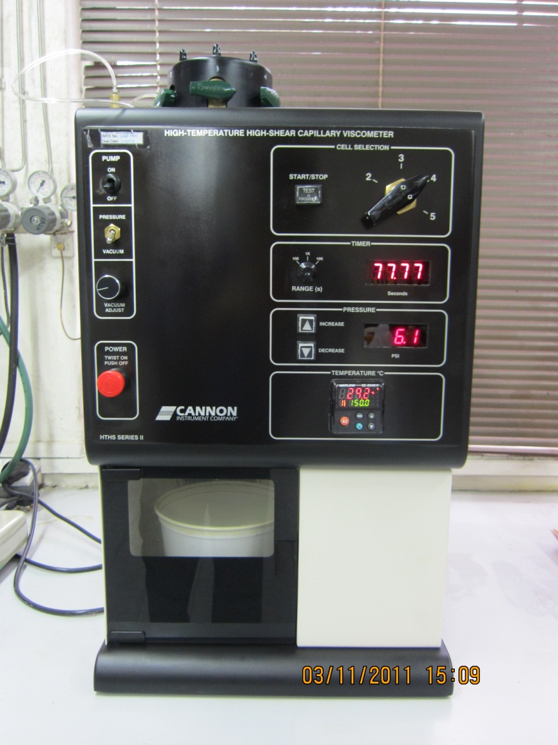
High Temperature High Shear
Capillary
Viscometer
www.united-oil.com

Slide 41
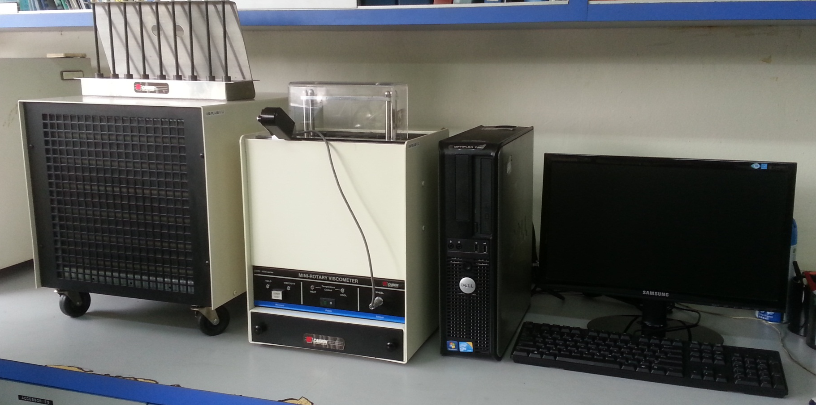
Mini-Rotary Viscometer (MRV)
www.united-oil.com

Slide 42
CERTIFIED BY:
www.united-oil.com

Slide 43
ISO 9001:2008
CERTIFICATION
LICENSE UNDER
API
www.united-oil.com

Slide 44
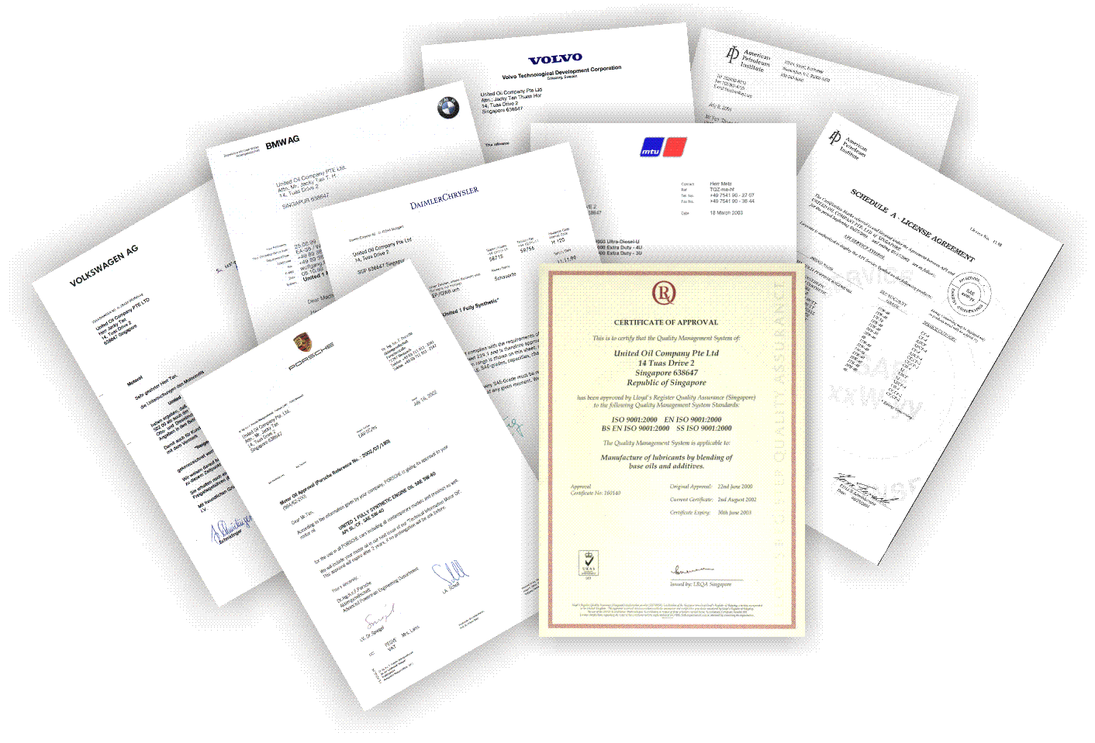
www.united-oil.com

Slide 45
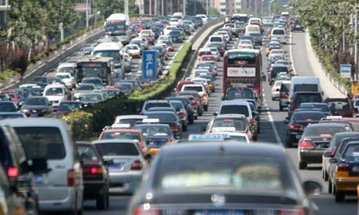
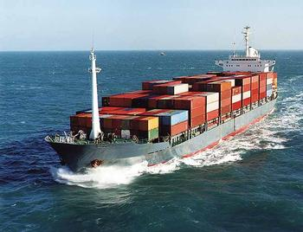
Product Range
www.united-oil.com

Slide 46
Our Vision
An international reputable lubricant chosen for its
Performance, Value & Reliability
www.united-oil.com

Slide 47
WIRANTO GROUP COMPANY
Lube Oil Blending Plant
www.united-oil.com

Slide 48
WIRANTO GROUP COMPANY
www.united-oil.com

Slide 49
WIRANTO GROUP COMPANY
Indonesia Plant
- Called PT Pacific Lubritama Indonesia
- 80,000 MT Blending Capacity/ year
- 11 Blending Tanks + 3 Decanting Tanks + 9 Holding Tanks in Blending Plant
- 3 Drumming Line with 5 Filling Head @ 400,000L/ 24H
- 1 Pail Line @ 60,000L/ 24H
4 Small Pack Line, from 15,000L/ 24H to 100,000L/ 24H depends on bottle size
3 Bulk truck Loading Lines
www.united-oil.com

Slide 50
WIRANTO GROUP COMPANY
www.united-oil.com

Slide 51
WIRANTO GROUP COMPANY
Indonesia Filling Capacity
14 Tanks with 17,000 MT Base Oil storage facility.
Private jetty integrated with blending plant tank farm with 900m pigged pipeline to facilitate oil tankers of up to 6M draft to discharge cargo to the plant. Typical cargo size by ship is 4,000 MT.
3,000m2 Lock up Warehouse and expanding to 5,000m2 by next year.
Close proximity to Jakarta, Bogor, Tanggerang & Bekasi.
www.united-oil.com

Slide 52
WIRANTO GROUP COMPANY
www.united-oil.com

Slide 53
WIRANTO GROUP COMPANY
www.united-oil.com

Slide 54
www.united-oil.com

Slide 55
www.united-oil.com

Slide 56
WIRANTO GROUP COMPANY
Lube Oil Packing Plant (UNT)
www.united-oil.com

Slide 57
WIRANTO GROUP COMPANY
2600 M2 Filling Plant
Located at Telok Gong, Klang, Malaysia
Start operating since October 2013
1 small pack filling line and 1 pail filling line.
Capacity similar to Singapore Plant
www.united-oil.com

Slide 58
WIRANTO GROUP COMPANY
www.united-oil.com

Slide 59
WIRANTO GROUP COMPANY
www.united-oil.com

Slide 60
WIRANTO GROUP COMPANY
www.united-oil.com

Slide 61
Comparative Advantages
Total Flexibility & Autonomy as both plants are privately owned.
Fast efficient production lead-time of 1 to 2 weeks for drums, 2 to 3 weeks for pails and 4 to 5 weeks for small packs.
Guarantee fixed volume allocated to Anchor OEM customer.
Order in Singapore and delivery from Singapore, Jakarta or Malaysia.
www.united-oil.com

Slide 62
www.united-oil.com

Slide 63
www.united-oil.com

Slide 64
www.united-oil.com

Slide 65
www.united-oil.com

Slide 66
www.united-oil.com

Slide 67
www.united-oil.com

Slide 68
www.united-oil.com

Slide 69
www.united-oil.com

Slide 70
www.united-oil.com

Slide 71
www.united-oil.com

Slide 72
www.united-oil.com

Slide 73
www.united-oil.com

Slide 74
www.united-oil.com

Slide 75
www.united-oil.com

Slide 76
www.united-oil.com

Slide 77
www.united-oil.com

Slide 78
www.united-oil.com

Slide 79
www.united-oil.com

Slide 80
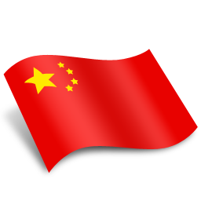
2020 Our Future, Our Growth
UNITED OIL MARKETS
Russia
Myanmar
Singapore
Malaysia
Australia
Russia
Bangladesh
China
Sri Lanka
Indonesia
Philippines
Vietnam
Cyprus
Bahrain
Lebanon
Pakistan
Papua New Guinea
17. Taiwan
18. Hong Kong
19. Macau
20. Thailand
21. Cambodia
22. Korea
23. Japan
24. Solomon Islands
25. Samoa
26. Fiji Islands
27. Yemen
28. Congo
29. Gabon
30. Ghana
31. New Zealand
China
Korea
Cyprus
Macau
Hong Kong
Japan
Lebanon
Bahrain
Pakistan
Taiwan
Myanmar
Vietnam
Bangladesh
Yemen
Thailand
Cambodia
Philippines
Ghana
Gabon
Sri Lanka
Malaysia
Congo
Papua New Guinea
Solomon Islands
Singapore
Indonesia
Total: 31 countries
Samoa
Fiji Islands
Australia
New Zealand
www.united-oil.com

Slide 81
THANK YOU FOR YOUR ATTENTION
www.united-oil.com

